Slide 1


CAPSTONE PROJECT
Education Infrastructure Analysis in India using Power BI
Presented By
Student Name:
College Name:
Department:
Email ID:
VETRISELVAN M
SNS COLLEGE OF TECHNOLOGY
BTECH IT
vetriselvan.m.it.2023@snsct.org

Slide 2
OUTLINE:
Problem Statement
Proposed System/Solution
System Development Approach
Algorithm & Deployment
Result (Output Image)
Conclusion
Future Scope
References

Slide 3
Problem Statement:
Education infrastructure plays a crucial role in improving the quality of education in a country. However, analyzing the distribution of educational institutions across different states can be difficult without proper data visualization tools.
Traditional reports often fail to provide clear insights into the number of schools available at different education levels such as primary, upper primary, secondary, and senior secondary.
Therefore, there is a need for a data-driven system that can analyze educational infrastructure and present insights through interactive visual dashboards to support better decision making.

Slide 4
Proposed Solution:
The proposed system aims to analyze education infrastructure data using Power BI.
The solution provides an interactive dashboard that visualizes the number of educational institutions across different states and education levels.
The dashboard helps to:
• Identify states with higher or lower numbers of schools • Compare different types of schools • Understand the distribution of educational institutions • Provide insights for policymakers and education planners
This system helps convert raw data into meaningful visual insights.

Slide 5
System Approach:
Tools & Technologies Used
• Power BI Desktop – Data Visualization • Microsoft Excel / CSV – Data Storage • NDAP (National Data & Analytics Platform) – Dataset Source
Development Steps
Data Collection from NDAP dataset
Data Cleaning and Preprocessing
Data Transformation
Data Visualization using Power BI
Dashboard Creation

Slide 6
Algorithm & Deployment:
Algorithm / Data Processing Steps
The project follows a structured data analysis workflow to transform raw educational data into meaningful insights.
Step 1 – Data Collection The dataset was collected from the National Data & Analytics Platform (NDAP) which provides government datasets related to various sectors including education.
Step 2 – Data Cleaning The dataset was cleaned by removing unnecessary rows, correcting column names, and ensuring proper data formats for analysis.
Step 3 – Data Transformation Data was transformed and organized using Power BI to prepare it for visualization. Additional calculated fields such as total number of schools were created.
Step 4 – Data Visualization Different Power BI visuals such as KPI cards, bar charts, stacked column charts, and pie charts were used to analyze the distribution of schools across states and education levels.
Deployment
The final Power BI dashboard was deployed locally using Power BI Desktop. The dashboard allows users to interact with the data and view insights through visual representations.

Slide 7
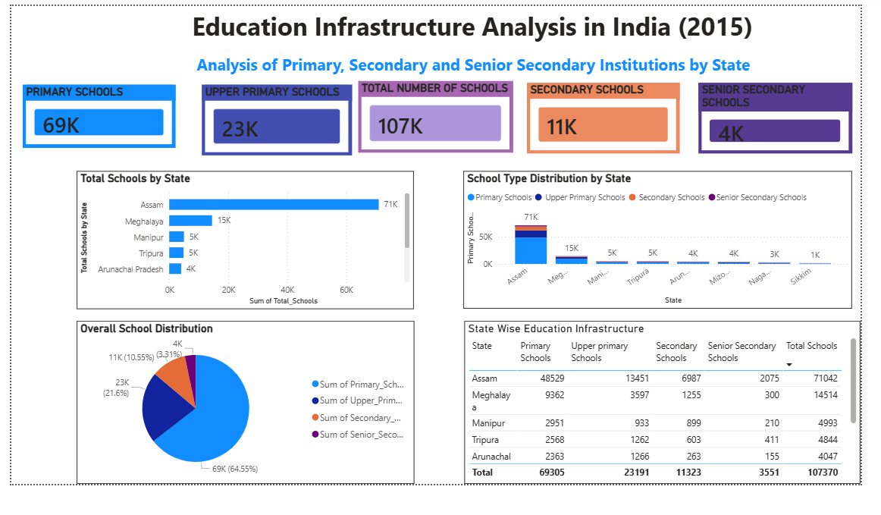
Result:

Slide 8
Conclusion:
This project successfully analyzed the distribution of educational institutions across different states using Power BI.
The dashboard provides clear insights into the availability of schools at different education levels. Visualizing the data helps identify patterns and gaps in educational infrastructure.
Such analysis can support better planning and resource allocation in the education sector.

Slide 9
Future scope:
The project can be enhanced in the future by:
• Adding data from multiple years to analyze trends over time • Including more states and districts for detailed analysis • Integrating additional educational indicators such as student enrollment and teacher ratio • Using predictive analytics to forecast future infrastructure needs
.

Slide 10
References:
• National Data & Analytics Platform (NDAP) https://ndap.niti.gov.in
• Microsoft Power BI Documentation https://learn.microsoft.com/power-bi
• Data Visualization Best Practices
GitHub Link: Link

Slide 11
Thank You

